Slide 1
IRELAND
Elizabeth Chiso Agbata Sarmiento
Paula Macías García
Carmen Trigueros Postigo

Slide 2
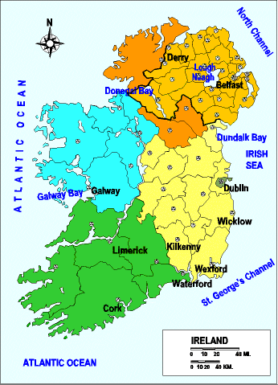
Location
Ireland is an island to the northwest of continental Europe. It is the third-largest island in Europe and the twentieth-largest island on Earth. To its east, the island of Great Britain; both countries are separated by the Irish Sea and North Channel.
Politically, Ireland is divided between the Republic of Ireland and Northern Ireland, a part of the United Kingdom.

Slide 3
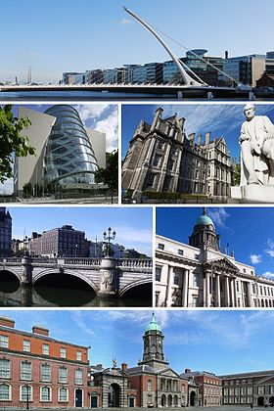
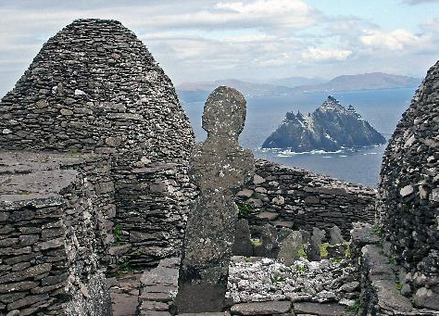
Dublin
Dublin is the capital of Ireland. It is the most heavily touristed region and home to several of the most popular attractions such as the Guinness Storehouse. The west and south west, which includes the Lakes of Killarney in Dingle peninsula. County Kerry is in this special city and is one of the tree World Heritage Sites on the island.
County Kerry

Slide 4
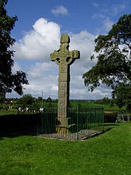
Culture
Ireland's culture comprises elements of the culture of ancient peoples, later immigrants and broadcast cultural influences. In broad terms, Ireland is regarded as one of the Celtic 'nations’ of Europe with Scotland, Wales, Cornwall, Isle of Man and Brittany.
Religion has played a significant role in the cultural life of the island since ancient times. The missions, spread the Irish vision of Christianity to pagan England and the Frankish Empire. These missions brought written language to an illiterate population of Europe during the Dark Ages that followed the fall of Rome.
Since the 20th century, the Irish pubs have become milestones of a full range of cultural and gastronomic offerings, outposts of Irish culture.

Slide 5
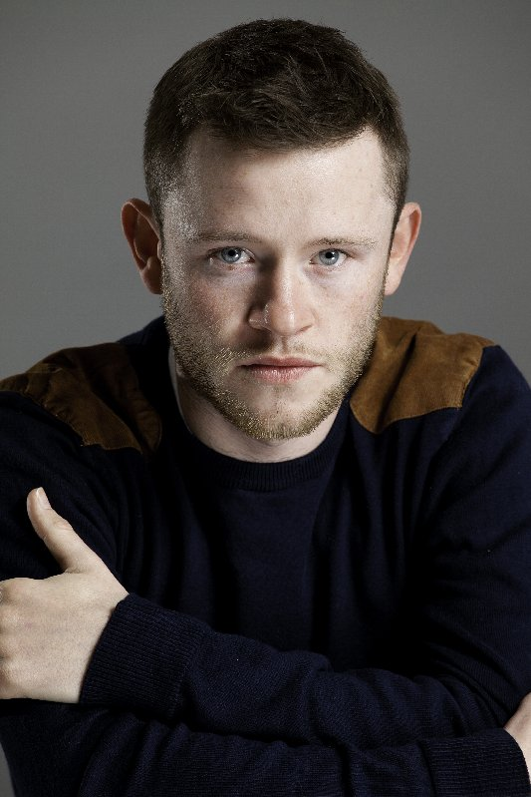
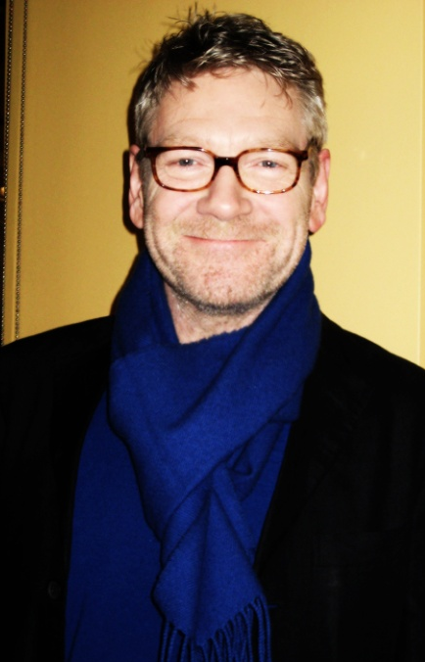
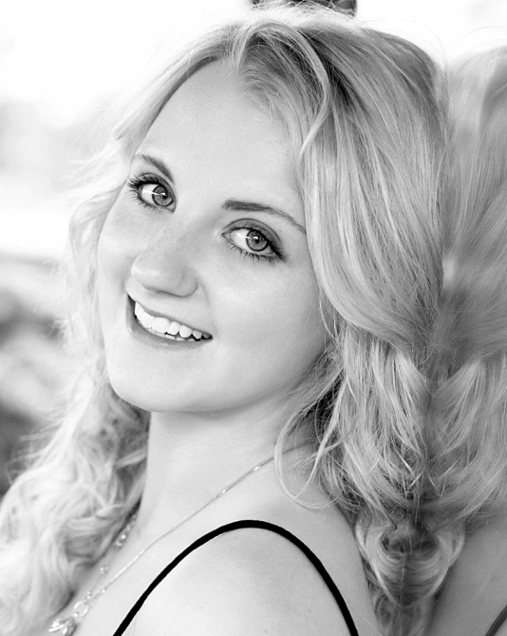
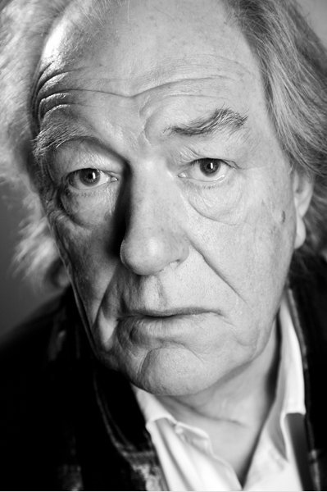
Famous People
Many famous people were born in this country. Some of them played in the films of Harry Potter.
Devon Murray
Kenneth Branagh
Michael Gambon
Evanna Lynch

Slide 6
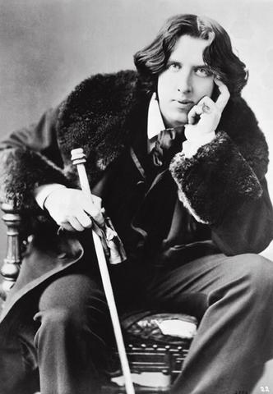
Oscar Wilde was also born in Ireland. He was an Irish writer and poet. He became one of London's most popular playwrights in the early 1890s.
Today he is remembered for his epigrams, his only novel The Picture of Dorian Gray and his worldwide known comedy The Importance of Being Earnest.

Slide 7
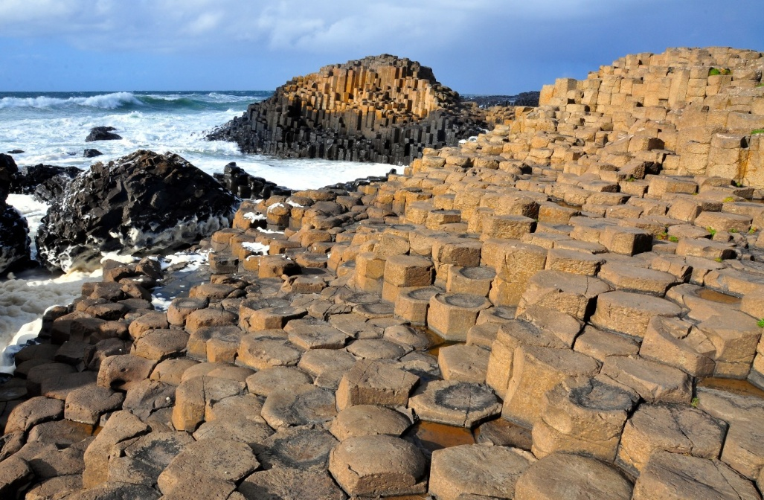
Places to Visit
There are tree World Heritage Sites in the island. Two of them are:
The Brú na Boinne
The Giant’s Causeway
The Giant's Causeway is an area of about 40,000 interlocking basalt columns, the result of an ancient volcanic eruption.
The legend of Giant´s Causeway says:
Long time ago a giant who lived in this causeway called Finn McCool decided to build a castle to live in this place. When he build it, other giant called Benandonner, jealous, destroyed the castle. This is because it is called The Giant’s Causeway.

Slide 8
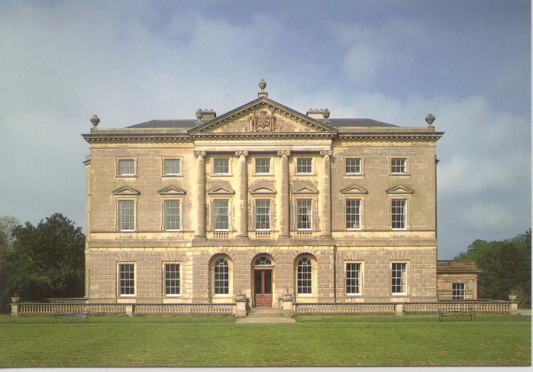
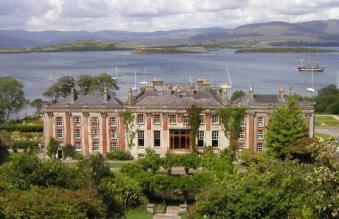
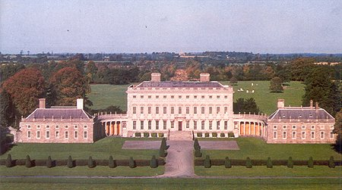
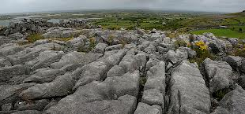
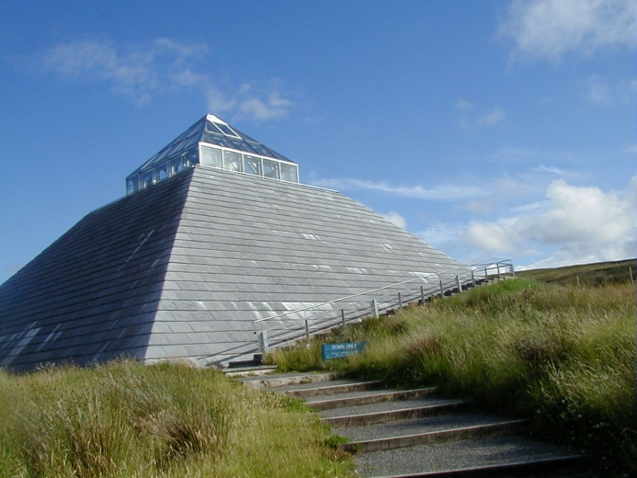
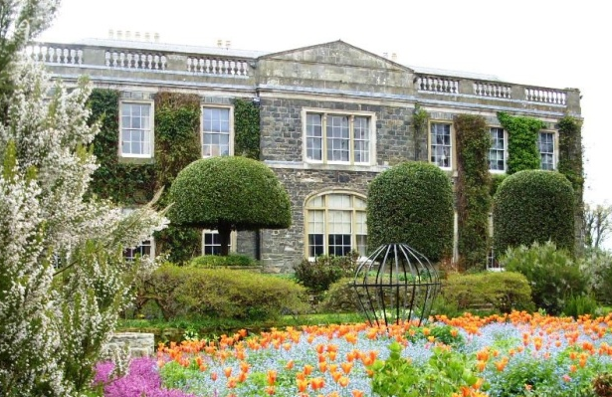
In Ireland, there are a lot of castles, stately homes, built during the 17th, 18th and 19th centuries in Palladian, Neoclassical and neo-Gothic styles, such as:
Castle Ward
Bantry House
Castletown House
A number of other places are on the list, for example:
The Burren
The Ceide Fields
Mount Steward

Slide 9
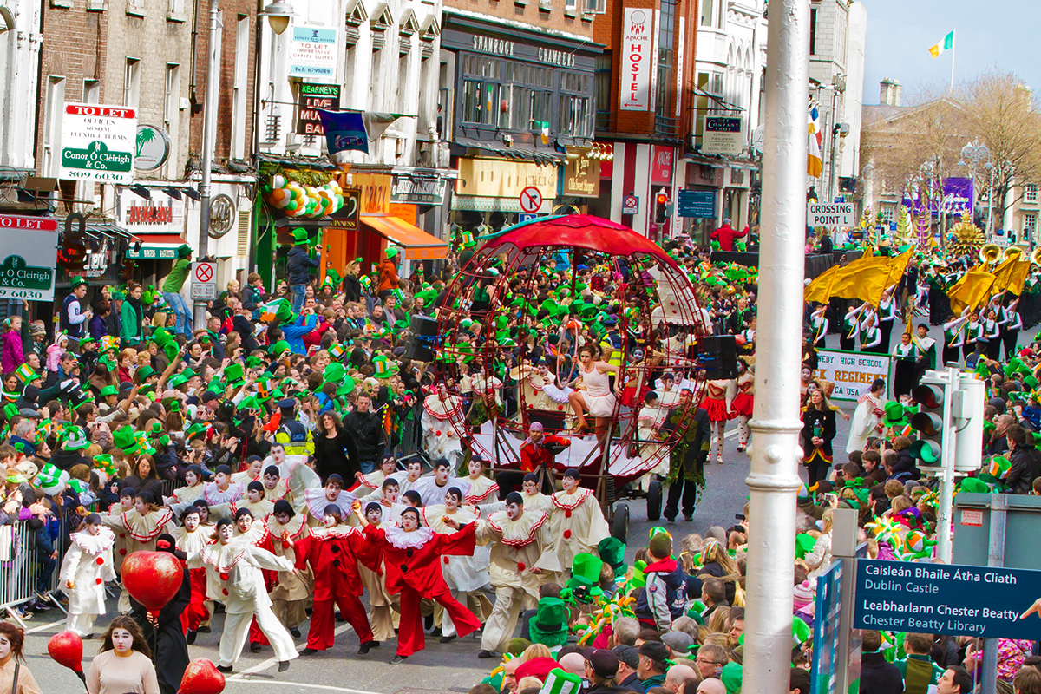
Saint Patrick’s Day
Saint Patrick's Day is a cultural and religious holiday celebrated on 17th March, the anniversary of his death.
It commemorates Saint Patrick, the most commonly recognised of the patron saints of Ireland and the arrival of Christianity in Ireland.
The festival has music, dance, culture, family, fun and more.
16th March to 19th March 2013

